Slide 1

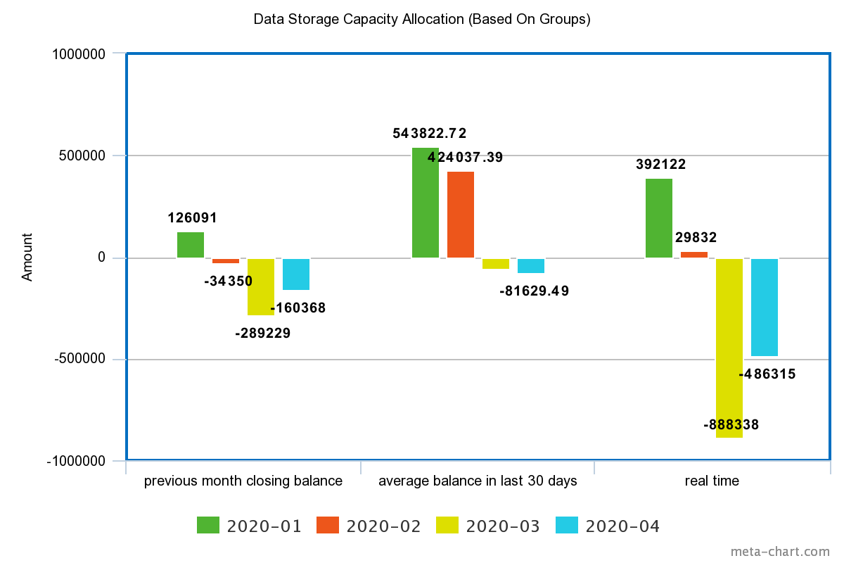
Observed Pattern of proposed Data Allocation Methods

